Slide 1
Engineering Drawing & Graphics
Engineering Drawing & CAD
Lecture 04
Projection of Lines
by
Umer Farooq
March, 2019

Slide 2
PROJECTIONS OF STRAIGHT LINES
POSSIBLE POSITIONS
  With Respect to H.P.
    Parallel to the H.P.
    Perpendicular to the H.P.
    Inclined to the H.P.
  With Respect to V.P.
    Parallel to the V.P.
    Perpendicular to the V.P.
    Inclined to the V.P.

Slide 3
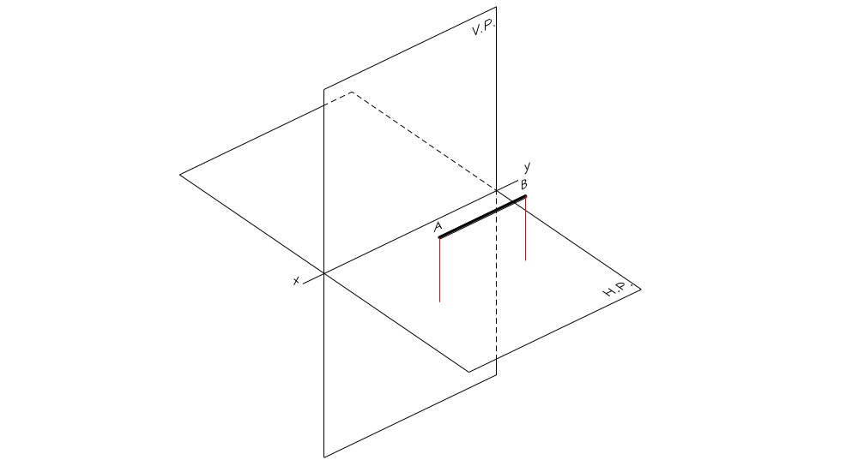
Parallel to the H.P.

Slide 4
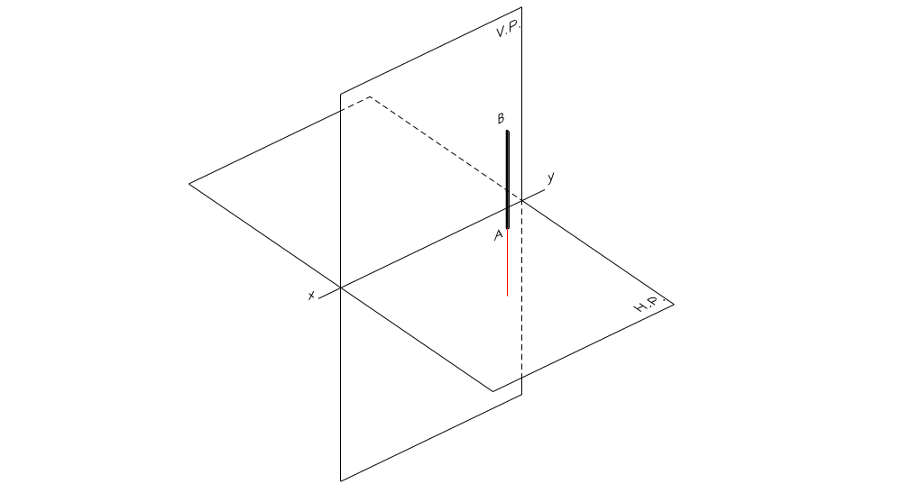
Perpendicular to the H.P.

Slide 5
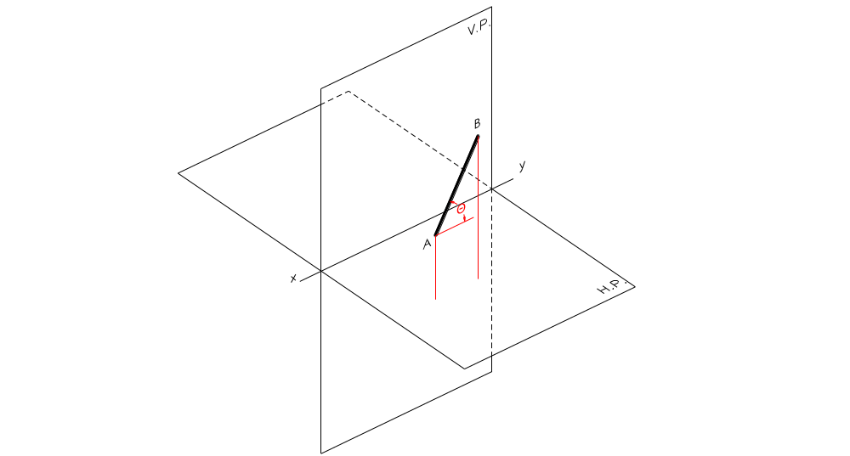
Inclined to the H.P.

Slide 6
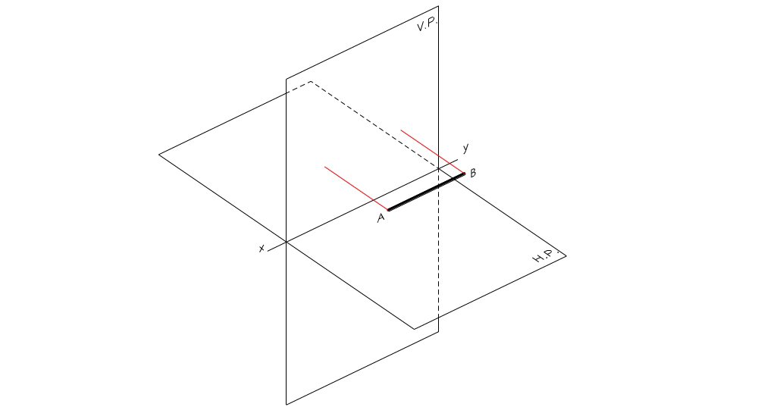
Parallel to the V.P.

Slide 7
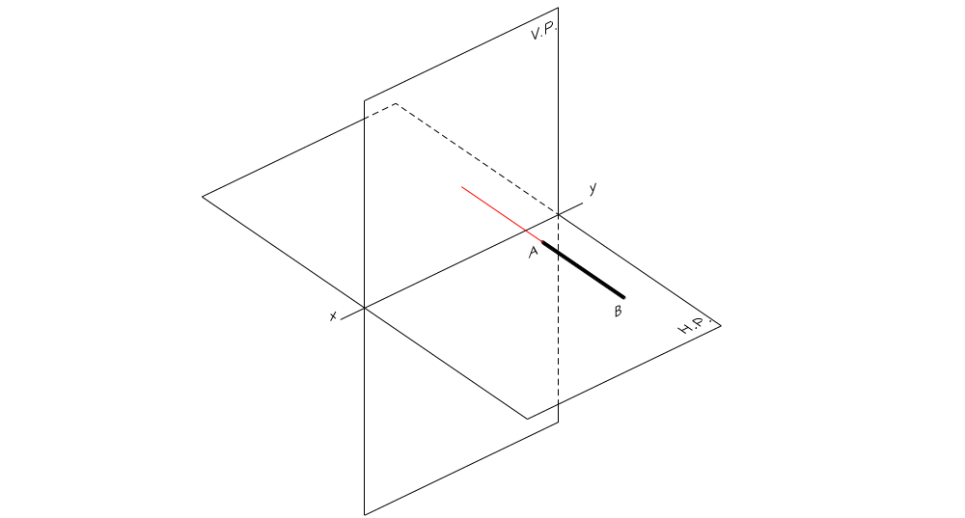
Perpendicular to the V.P.

Slide 8
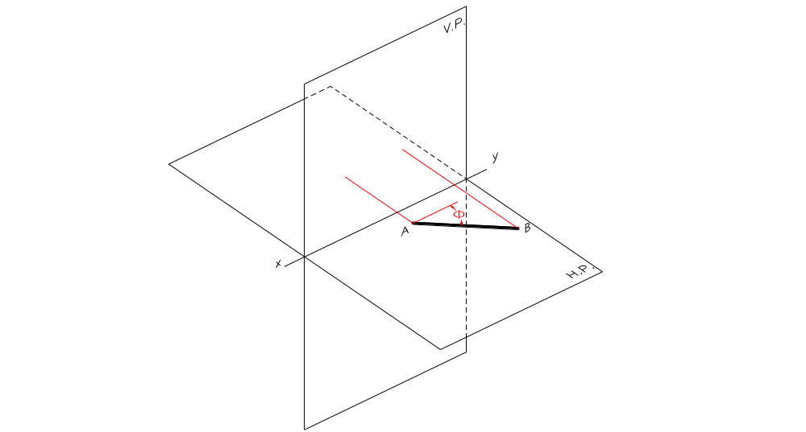
Inclined to the V.P.

Slide 9
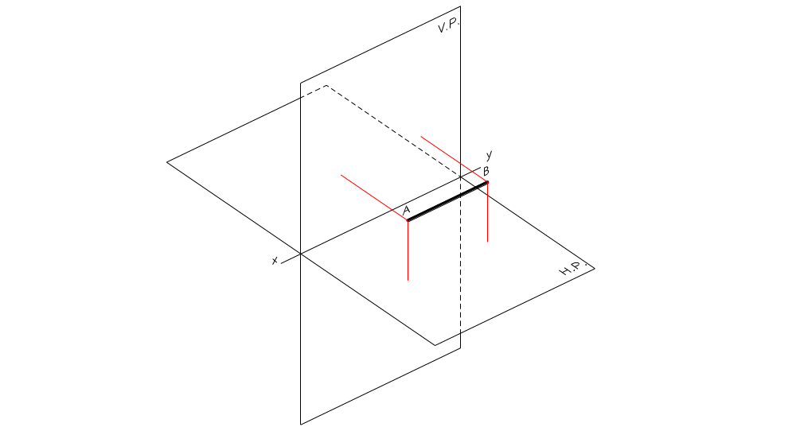
Parallel to Both Planes

Slide 10
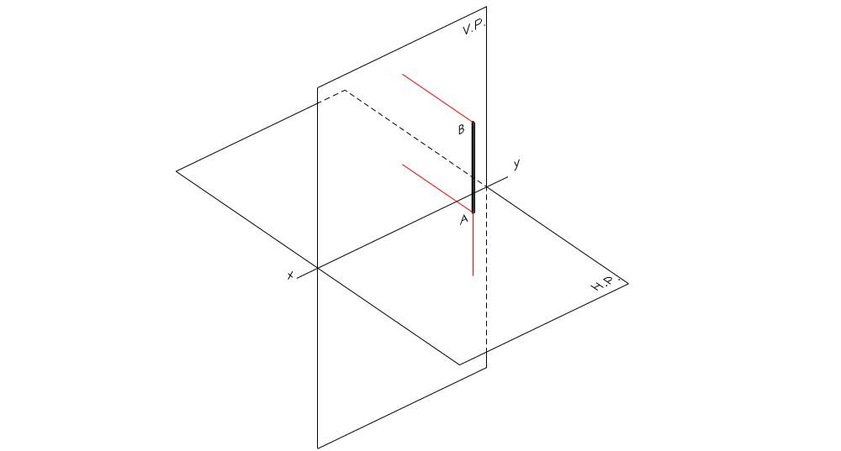
Perpendicular to One Plane (parallel to the other plane)
  Perpendicular to H.P. (must be parallel to the V.P.)

Slide 11
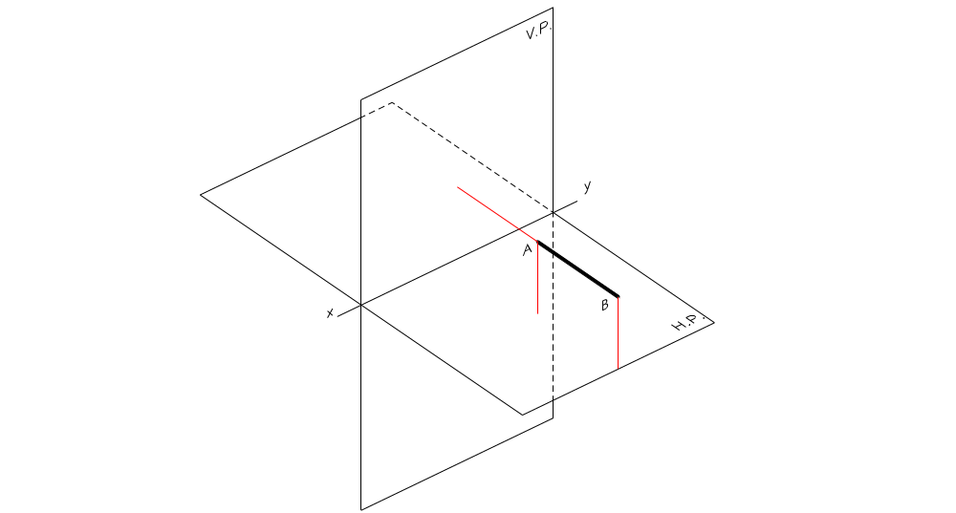
  Perpendicular to V.P. (must be parallel to the H.P.)

Slide 12
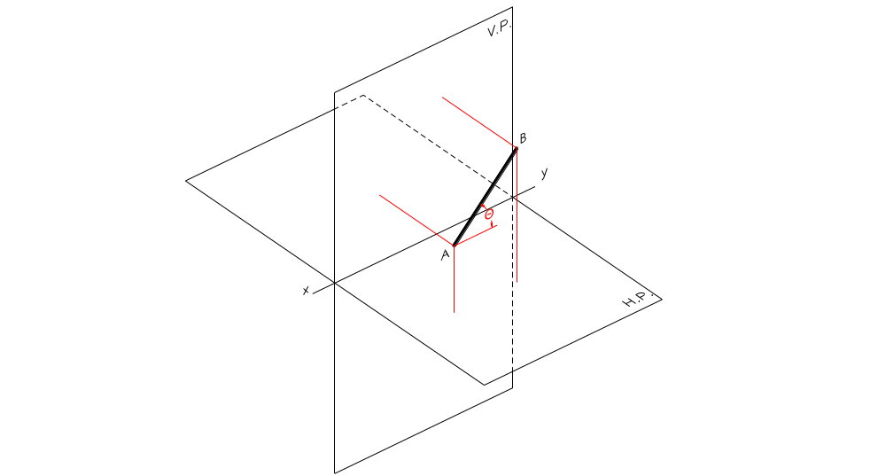
Inclined to One Plane and parallel to the other plane
  Inclined to the H.P. and parallel to the V.P.

Slide 13
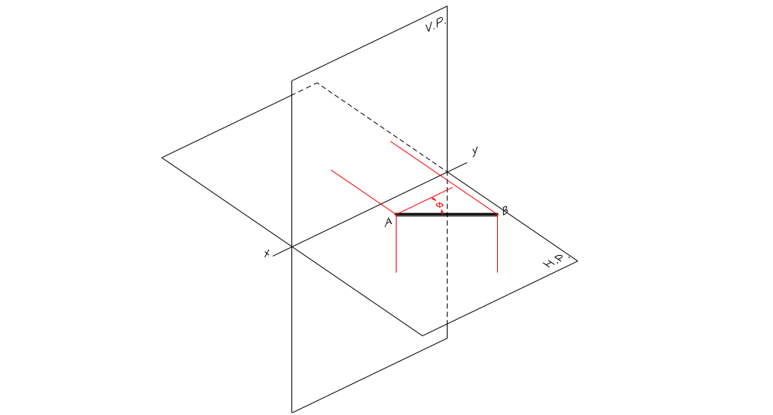
Inclined to One Plane and parallel to the other plane
  Inclined to the V.P. and parallel to the H.P.

Slide 14
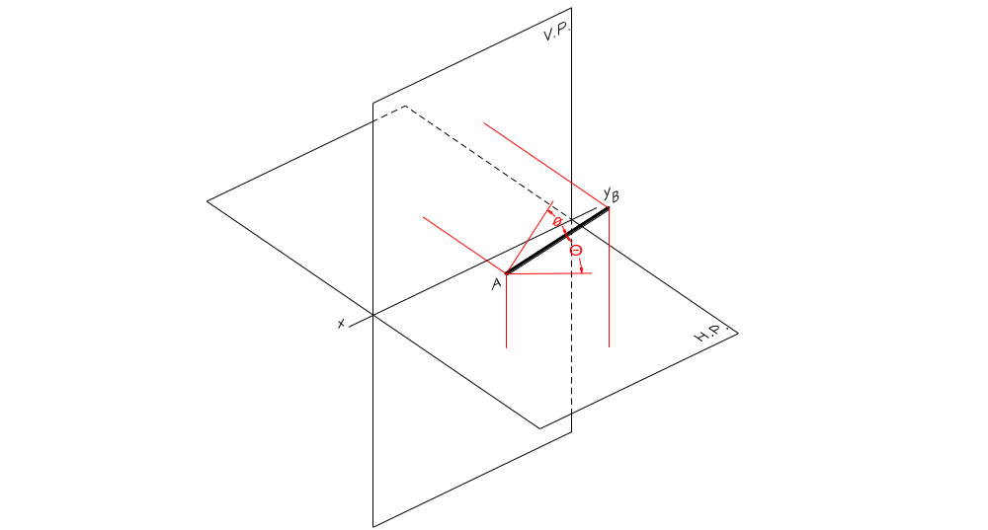
Inclined to Both Planes

Slide 15
POSITIONS OF A STRAIGHT LINE WITH RESPECT TO THE TWO PLANES
Parallel to both planes
Perpendicular to one plane (must be parallel to the other plane)
    Perpendicular to the H.P. (must be parallel to the V.P.)
    Perpendicular to the V.P. (must be parallel to the H.P.)
Inclined to one plane and parallel to the other plane
    Inclined to the H.P. and parallel to the V.P.
    Inclined to the V.P. and parallel to the H.P.
Inclined to both planes

Slide 16
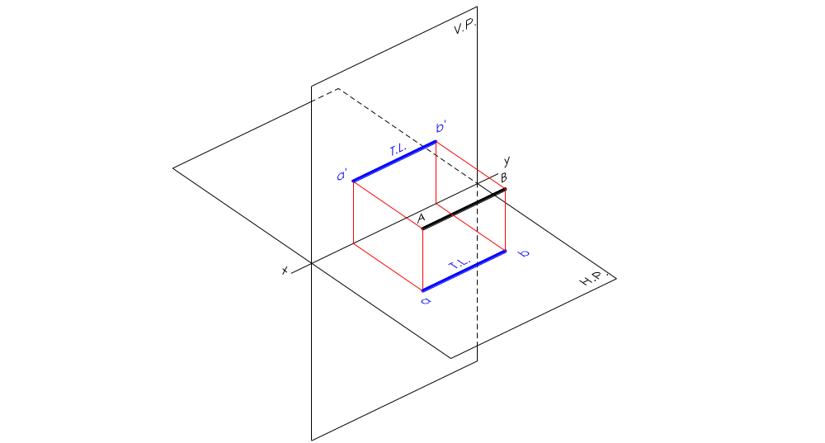
PROJECTION RULE OF PARALLELISM
If a straight line is parallel to a principal plane, its projection on the same principal plane must be equal to its True Length (T.L.), whereas its projection on the other principal plane must be parallel to the xy line.
Line is parallel to the H.P., therefore its T.V. is T.L. and F.V. parallel to xy.
Line is parallel to the V.P., therefore its F.V. is T.L. and T.V. parallel to xy.

Slide 17
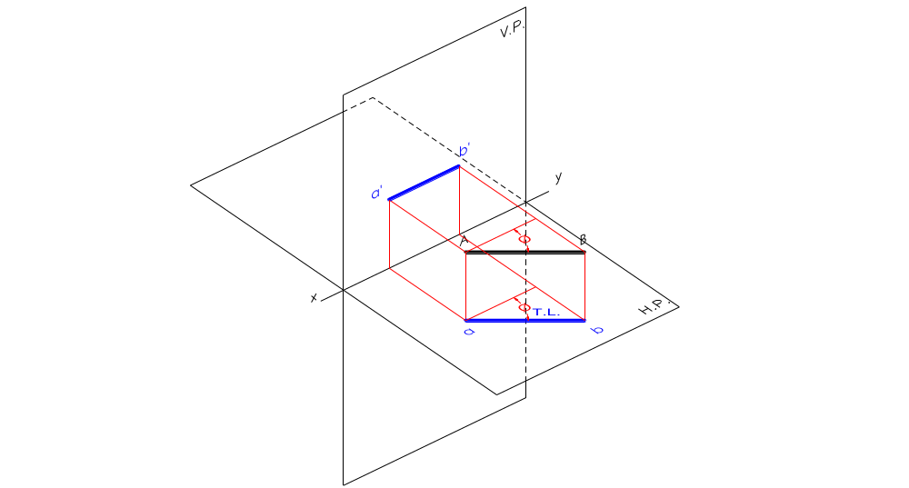
Line is parallel to the H.P., therefore its T.V. is T.L. and F.V. parallel to xy.

Slide 18
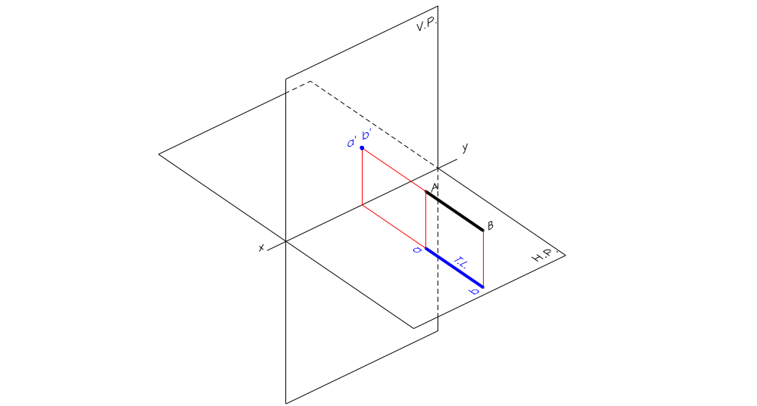
Line is parallel to the H.P., therefore its T.V. is T.L. and F.V. parallel to xy.

Slide 19
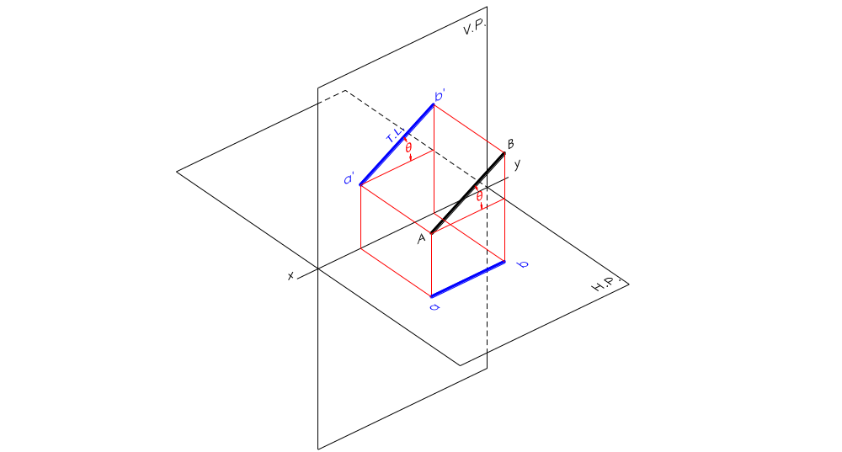
Line is parallel to the V.P., therefore its F.V. is T.L. and T.V. parallel to xy.

Slide 20
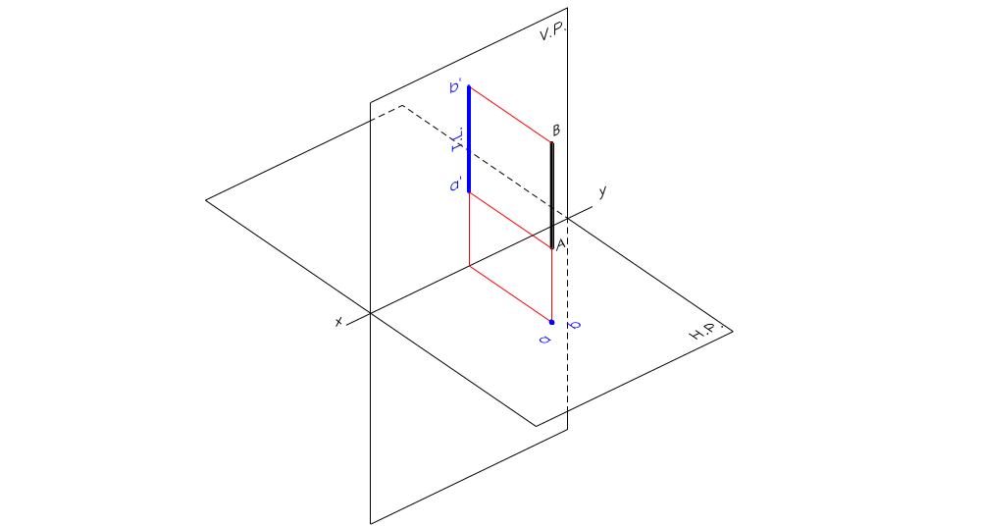
Line is parallel to the V.P., therefore its F.V. is T.L. and T.V. parallel to xy.

Slide 21
If the F.V. is T.L., then the T.V. is parallel to xy line.
If the T.V. is T.L., then the F.V. is parallel to xy line.
If the T.V. is parallel to xy line, then the F.V. is T.L.
If the F.V. is parallel to xy line, then the T.V. is T.L.
If one view is T.L., the other must be parallel to xy.
If one view is parallel to xy, the other must be T.L.

Slide 22
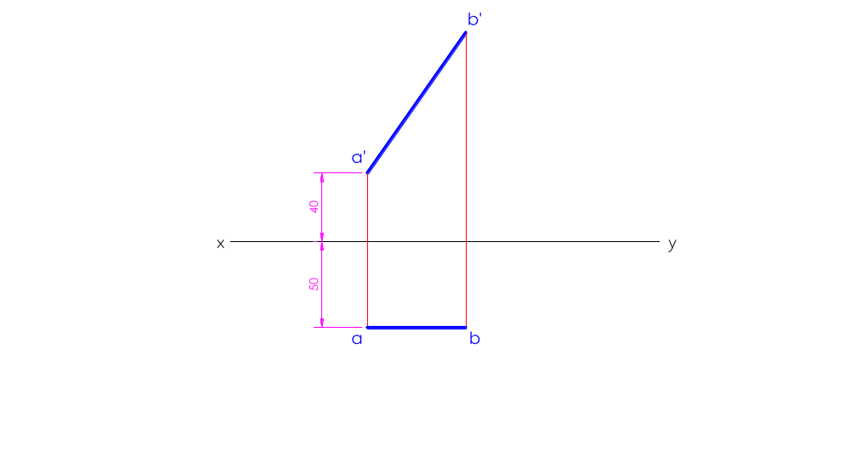

Slide 23
Straight line AB
End A is 40 mm above the H.P. and 50 mm in front of the V.P.
Line is parallel to the V.P. and inclined to the H.P., therefore F.V. (a’b’) is T.L.
End B is also above the H.P. and in front of the V.P.

